Slide 1
Septicemia and septic shock
Dr.Alaa khattar Mousa
Ass. Prof. internal medicine- infectious diseases
Department of medicine/ College of Medicine / Basrah university 2019

Slide 2
Objectives
Define SARS, Sepsis , septicemia and septic shocks.
Identify the possible causes .
Describe the stages of sepsis and the clinical features in each stages
Discuss the investigations needed to for early diagnosis of sepsis
Assessment of severity by clinical and laboratory tests
Discuss the lines of treatment of shock
How to choice antibiotic according to site of infection and other supportive management

Slide 3
SEPTIC SHOCK OVERVIEW
Etiology
Microbiology
Pathophysiology
Diagnosis
Management

Slide 4
SEPTIC SHOCK IMPACT
Results in approximately 215,000 deaths annually in the U.S.
Similar in frequency to MI as a cause of death

Slide 5
Distributive Shock
Septic Shock

Slide 6
SEPTIC SHOCK PREDISPOSING FACTORS
Extended hospitalization
Advanced age
Debilitating illness
Immunodeficiency disorder
Ventilator > 48 h

Slide 7
SEPTIC SHOCK PREDISPOSING FACTORS
Disseminated malignancy
Hyperalimentation
Biliary tract surgery
Genital tract surgery

Slide 8
SEPTIC SHOCK MICROBIOLOGY

Slide 9
SEPTIC SHOCK PATHOPHYSIOLOGY
Endotoxin→stimulation of humoral and cellular immune systems→activation of complement sequence and coagulation cascade

Slide 10
SEPTIC SHOCK PATHOPHYSIOLOGY
Activation of coagulation cascade→ activation of fibrinolytic system→ DIC

Slide 11
SEPTIC SHOCK PATHOPHYSIOLOGY
Complement activation→chemotaxis of PMNs, degranulation of mast cells, and release of histamine and inflammatory mediators→increased capillary permeability

Slide 12
SEPTIC SHOCK PATHOPHYSIOLOGY
INFLAMMATION→ release of catecholamines and prostaglandins→ generalized vasoconstriction

Slide 13
SEPTIC SHOCK PATHOPHYSIOLOGY
VASOCONSTRICTION→ decreased perfusion of vital organs→ tissue hypoxia→ metabolic acidosis

Slide 14
SEPTIC SHOCK PATHOPHYSIOLOGY
METABOLIC ACIDOSIS→ capillary pooling→ decreased circulating blood volume→ decreased venous return→ decreased cardiac output

Slide 15
SEPTIC SHOCK PATHOPHYSIOLOGY
DECREASED CARDIAC OUTPUT→ decreased coronary and cerebral blood flow→ intractable hypotension, coma, multiorgan failure→ DEATH

Slide 16
SEPTIC SHOCK CLINICAL MANIFESTATIONS
Altered mental status
Thermal instability
Cardiac dysfunction
Respiratory compromise

Slide 17
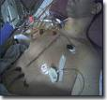
SEPTIC SHOCK CLINICAL MANIFESTATIONS
Bleeding
Jaundice
Ileus
Skin changes

Slide 18
SEPTIC SHOCK DIFFERENTIAL DIAGNOSIS
Cardiogenic shock
Hypovolemic shock
Venous or AF embolism
Cardiac tamponade

Slide 19
SEPTIC SHOCK DIFFERENTIAL DIAGNOSIS
Hemorrhagic pancreatitis
Diabetic ketoacidosis
Aortic dissection

Slide 20
SEPTIC SHOCK DIAGNOSTIC TESTS
Laboratory Test | Result
WBC | Decreased, then increased
HCT | Variable
PLT | Decreased with DIC
Fibrinogen | Decreased with DIC

Slide 21
SEPTIC SHOCK DIAGNOSTIC TESTS
Laboratory Test | Result
Fibrin degradation products | Increased with DIC
PT, PTT, TT | Prolonged with DIC
pH | Decreased
Lactic acid | Increased (poor prognostic factor)

Slide 22
SEPTIC SHOCK DIAGNOSTIC TESTS
Laboratory Test | Result
pO2 | Decreased
pCO2 | Increased
HCO3 | Decreased
K+ | Increased

Slide 23
SEPTIC SHOCK MICROBIOLOGY STUDIES
Urine culture
Blood culture
Culture of peritoneal fluid
Culture of abscess
Sputum culture

Slide 24
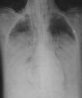
SEPTIC SHOCK IMAGING STUDIES
Chest x-ray
Abdominal films
IVP
CT
MRI
Ultrasound

Slide 25
SEPTIC SHOCK OTHER DIAGNOSTIC STUDIES
ECG
Right heart catheterization

Slide 26
SEPTIC SHOCK MANAGEMENT
Monitoring
CO
PCWP
BP
ABGs
Urine output

Slide 27
SEPTIC SHOCK MANAGEMENT
Restore circulating blood volume
Packed red blood cells
Maintain hemoglobin of 7 to 9 g/l
Crystalloid
Ringer’s lactate
Normal saline

Slide 28
SEPTIC SHOCK MANAGEMENT
“7 – 3 rule” for fluid replacement
Infuse 150-200 ml/10 minutes
If PCWP increases > 7mm Hg, discontinue infusion temporarily
If PCWP increases < 3 mm Hg, infuse a second increment

Slide 29
SEPTIC SHOCK GOALS OF FLUID RESUSCITATION
Central venous pressure of 8 to 12 mm Hg
Mean arterial pressure > 65 mm Hg
Urine output > 0.5 ml/kg/h
Central venous or mixed venous oxygen saturation > 70%

Slide 30
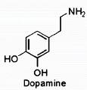
SEPTIC SHOCK VASOPRESSORS
Dopamine
Starting dose 1-3 mcg/kg/min
Norepinephrine
5 to 15 mcg/min
Vasopressin
0.01 to 0.03 U/min

Slide 31
SEPTIC SHOCK INOTROPIC THERAPY
Dobutamine - first choice inotrope for patients with low CO in the presence of adequate LV filling pressure
Dose
0.5 to 1 mcg/kg/min
Maximum – 40 mcg/kg/min

Slide 32
SEPTIC SHOCK MANAGEMENT
Corticosteroids
Dose – 200-300 mg/day for 7 days in 3 or 4 divided doses or by continuous infusion

Slide 34
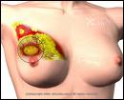
SEPTIC SHOCK SURGICAL INTERVENTION
Drainage of abscess
Debridement of infected wound
Removal of infected organ

Slide 35
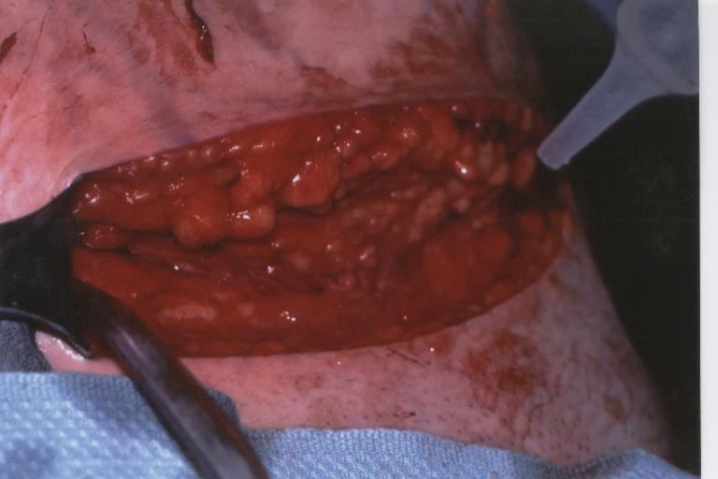
SEPTIC SHOCK ANTIBIOTIC THERAPY
Antibiotics should be started within one hour of diagnosis of sepsis/hypotension→ improved survival
Initial empiric regimen should target most likely pathogens, e
Reassess regimen after 48-72 hours
Total duration of treatment- 7 to 10 days

Slide 36
SEPTIC SHOCK POSSIBLE MODIFICATIONS IN ANTIBIOTIC ADMINISTRATION
Prolong the intravenous infusion to 3 to 4 hours
For ventilator-related infections, administer nebulized antibiotics

Slide 39
SEPTIC SHOCK MINIMIZING INFLAMMATION
Recombinant human activated protein C
Inhibits thrombin
Inhibits neutrophil recruitment
Inhibits apoptosis
Improves survival in patients with multi-organ dysfunction
Dose - 24 micrograms/kg/min x 96 hours

Slide 40
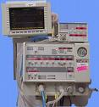
SEPTIC SHOCK RESPIRATORY SUPPORT
Administer oxygen
Monitor ABGs
Initiate mechanical ventilation early
Avoid barotrauma
Use PEEP as indicated

Slide 41
EFFECT OF ARDS ON MORTALITY IN SEPTIC SHOCK
Condition | Mortality %
Septic shock without ARDS | 50
Septic shock with ARDS | 90

Slide 42
MANAGEMENT OF SEPTIC SHOCK OTHER SUPPORTIVE MEASURES
Maintain normal temperature
Correct coagulation abnormalities
Maintain glucose < 150 mg/dl
Administer WBC transfusion
DVT prophylaxis

